Slide 1








第七届中国计算蛋白质组学研讨会(CNCP-2023)
Glyco-Decipher 2.0:
Towards Comprehensive Interpretation of the Spectra of O-glyco and N-glycopeptides
Mingliang Ye
(叶明亮）

Slide 2
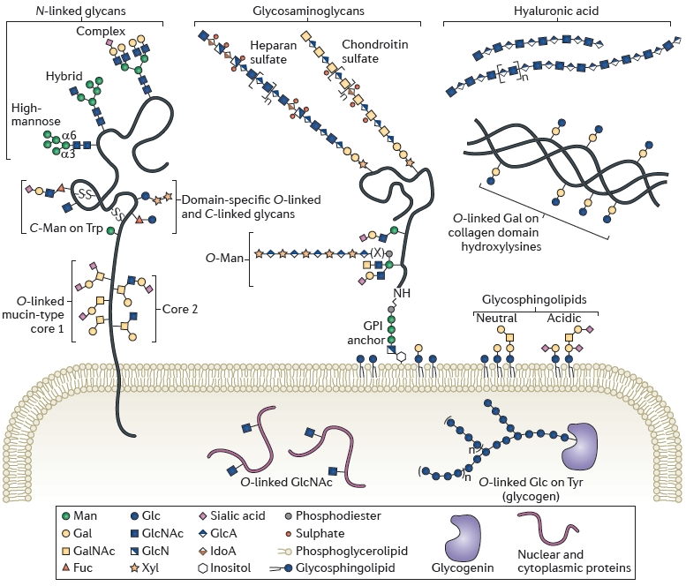
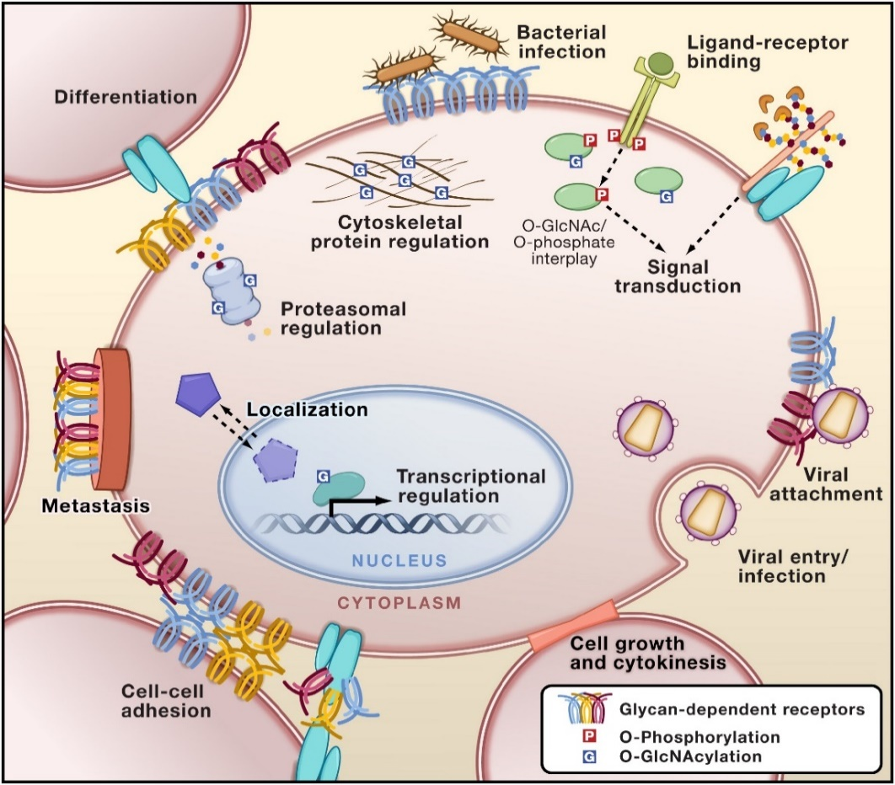
Protein glycosylation is the most abundant and structurally diverse type of PTM
More than half of all proteins are glycoproteins
Regulating diverse biological processes
Moremen, Nat. Rev. Mol. Cell. Biol., 2012, 13, 448-462.
Hart et al, Cell 143, 672-676 (2010).
Notes:
Enzyme Activity, Cell-Cell Adhesion, Cell Growth, Cell Differentiation
Complex glycans at the cell surface are targets of microbes and viruses, regulate cell adhesion and development, influence metastasis of cancer cells, and regulate myriad receptor:ligand interactions. Glycans within the secretory pathway regulate protein quality control, turnover, and trafficking of molecules to organelles. Nucleocytoplasmic O-linked N-acetylglucosamine (O-GlcNAc) has extensive crosstalk with phosphorylation to regulate signaling, cytoskeletal functions, and gene expression in response to nutrients and stress.

Slide 3
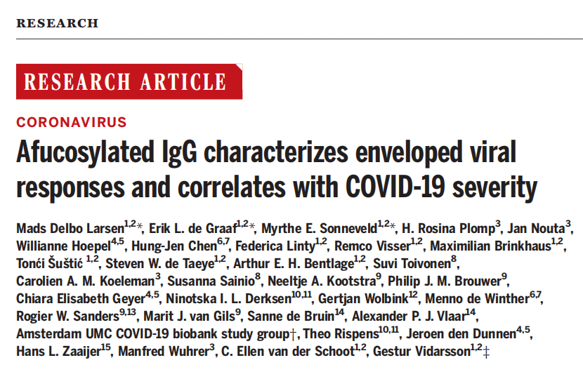
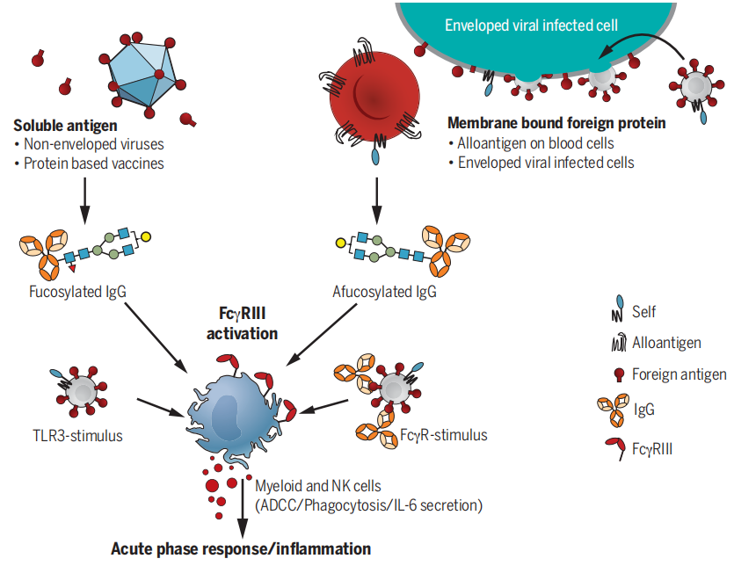
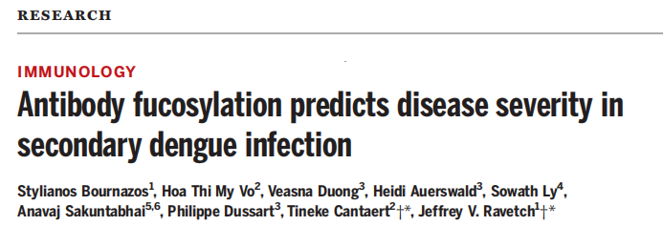
Larsen et al., Science 371, eabc8378 (2021)
Bournazos et al., Science 372, 1102–1105 (2021)
非岩藻糖修饰的IgG抗体会引起更强的免疫反应，进而触发炎症风暴和急性呼吸窘迫综合征，并最终导致COVID-19重症的产生
甜蜜的诱饵：糖基化修饰的抗体竟是病毒入侵的“帮凶”
Notes:
modifying the Fc domain with chains of sugar molecules (glycosylation) can trigger cellular immune functions that can either protect against or worsen viral diseases, such as dengue and COVID-19.

Slide 4
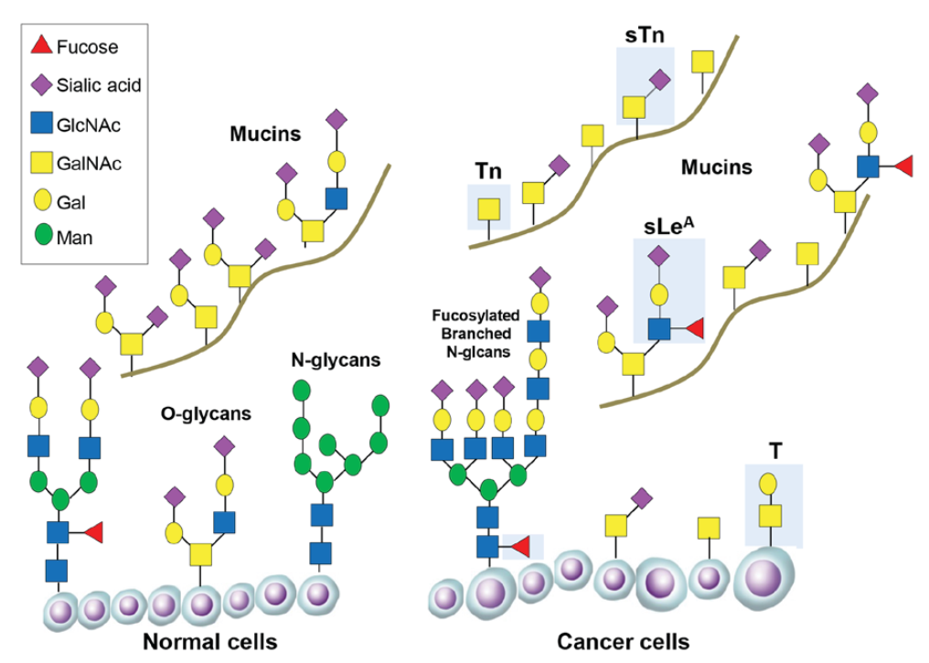
Changes in glycosylation during cancer progression
Abnormal changes in protein glycosylation are a hallmark of tumor development
Truncated O-glycans (Tn and sTn)
Fucosylated branched N-glycans (sLeA and SLeX)
Highly branched N-glycans
CA199
Munkley, et al, Oncol Lett., 2019 , 17(3):2569-2575

Slide 5
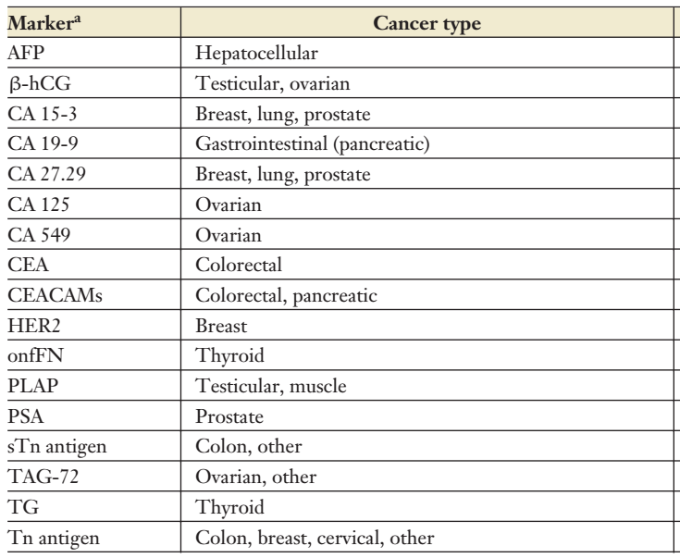

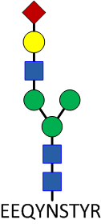
Almost all tumor markers are related with protein glycosylation
Target protein antigen, determining protein concentration
?
Target glycan antigen, determining glycan concentration
No site specifc glycan tumor marker available

Slide 6
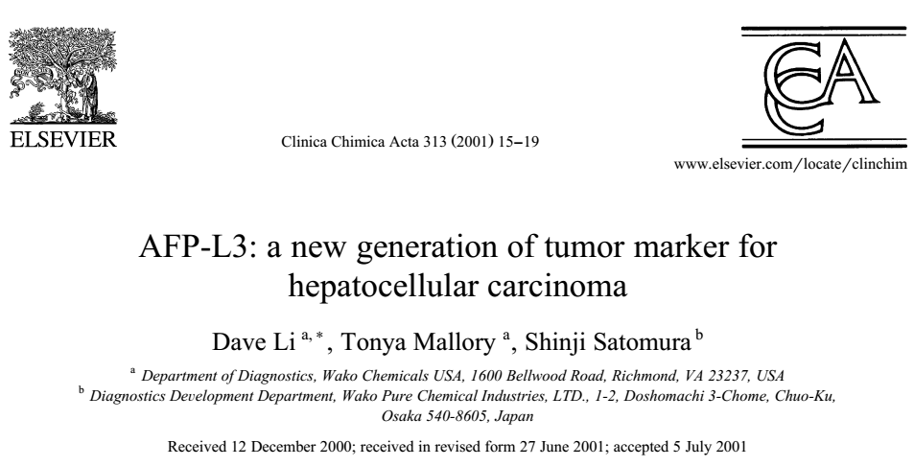
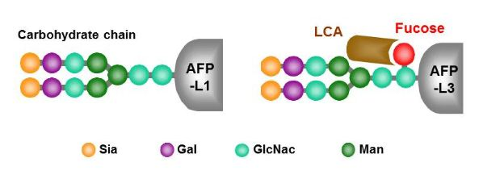
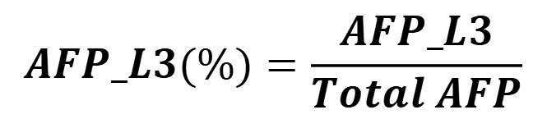
AFP-L3 is the only protein specific glycan biomarker
The Lens culinaris agglutinin (LCA)-reactive fraction of a-fetoprotein (AFP-L3) is the only protein specific glycan biomarker used in clinic
AFP-L3 is a core fucosylated glycoprotein
Elevated AFP-L3 values (>=10%) have been shown to be associated with a 7-10 fold increased risk of HCC development within the next 21 months, for chronic liver disease patients
$$AFP_L3(\%)=\frac{AFP_L3}{Total AFP}$$

Slide 7
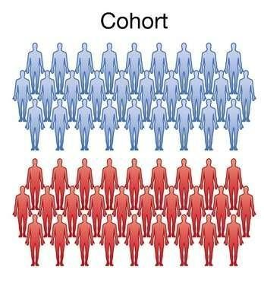
Why no site specific glycoform tumor bimarker?
Lacking
Robust and sensitive analysis system
Site specific glycoform biomarker
Currently the largest corhort size for the site specific glycoform anlaysis at proteomics scale is less than 100.
Our research focus:
Developing robust and senstive glycoproteomics platform facilitating highly reproducible analysis of serum site-specific glycoforms for biomarker discovery

Slide 8
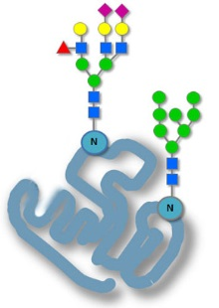
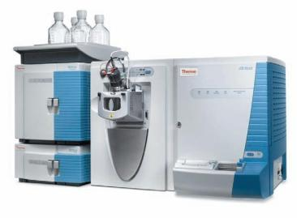
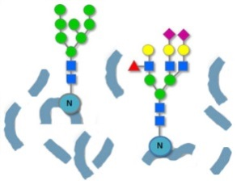
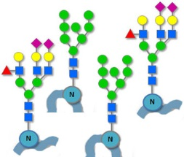
The workflow for the proteomics analysis of site specific glycoforms
2) Robust Schemes
digestion
enrichment
separation
1) Software tools
spectra interpretation
Site specifc glycoforms

Slide 9
Robust Workflow for High-Throughput Glycosylation Analysis
Robust
High Throughput
High Sensitivity
Protein
Site
Glycan
Site-specific glycan
Glycopeptide
Enrichment
LC-MS/MS
Acquisition
Data
Analysis
Sample
✖ Manual operation
✖ Limited throughput
✖ Low reproducibility
✖ Nano-flow
✖ Limited throughput
✖ Low reproducibility
✖ Limited sensitivity
✖ Quantification accuracy
✖ User-friendly interface
Existing problems:
Our work:
✓ Auto-HILIC enrichment
Anal.Chem., 2021
✓ Micro-flow LC system
✓ Glyco-Decipher
Nat. Commun., 2022
✓ MS-Decipher
Bioinformatics, 2022
Anal. Chem., 2023
HPLC HILIC column (50 mm × 2.1 mm I.D.),
Provided by Prof. Xingmiao Liang)
HPLC C18 column
(150mm × 1.0 mm I.D)

Slide 10
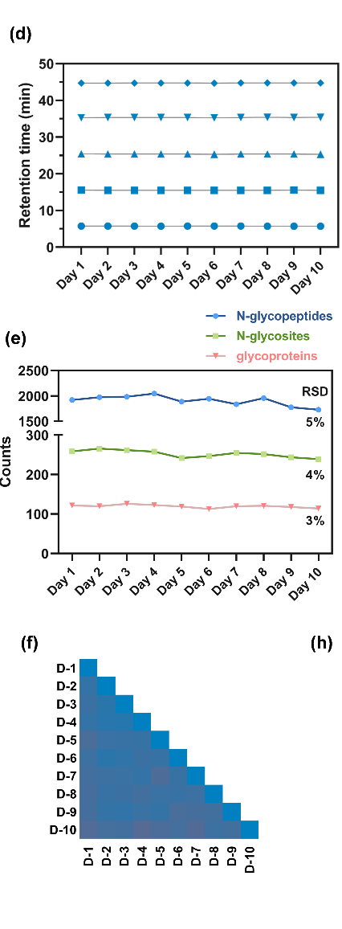
Applied to screen the serum site-specific glycan biomarker for gastric cancer
Notes:
Figure 1. Workflow of serum site-specific glycan biomarker discovery by a highly robust N-glycoproteomic (HRN) platform. In the HRN platform, serum N-glycopeptides were enriched by an automated HPLC-HILIC method, detected by a stable microflow LC-MS/MS system, and identified with high-sensitive Glyco-Decipher software. Site-specific glycan biomarker candidates were determined through comprehensive consideration in discovery and validation cohorts using shotgun glycoproteomics, and then confirmed in a verification cohort using targeted glycoproteomics.

Slide 11
Outline
01
Glyco-Decipher: Comprehensive Interpretation of N-Glycopeptide Mass Spectra
02
GP-Plotter: Flexible Visualization of Glycoproteomics Mass Spectrometry Data
03
MS-Decipher: Novel Strategy for Identification of O-Glycopeptide
04
Glyco-Decipher 2.0: Towards Simultaneous Analysis of O-/N-Glycopeptides

Slide 12
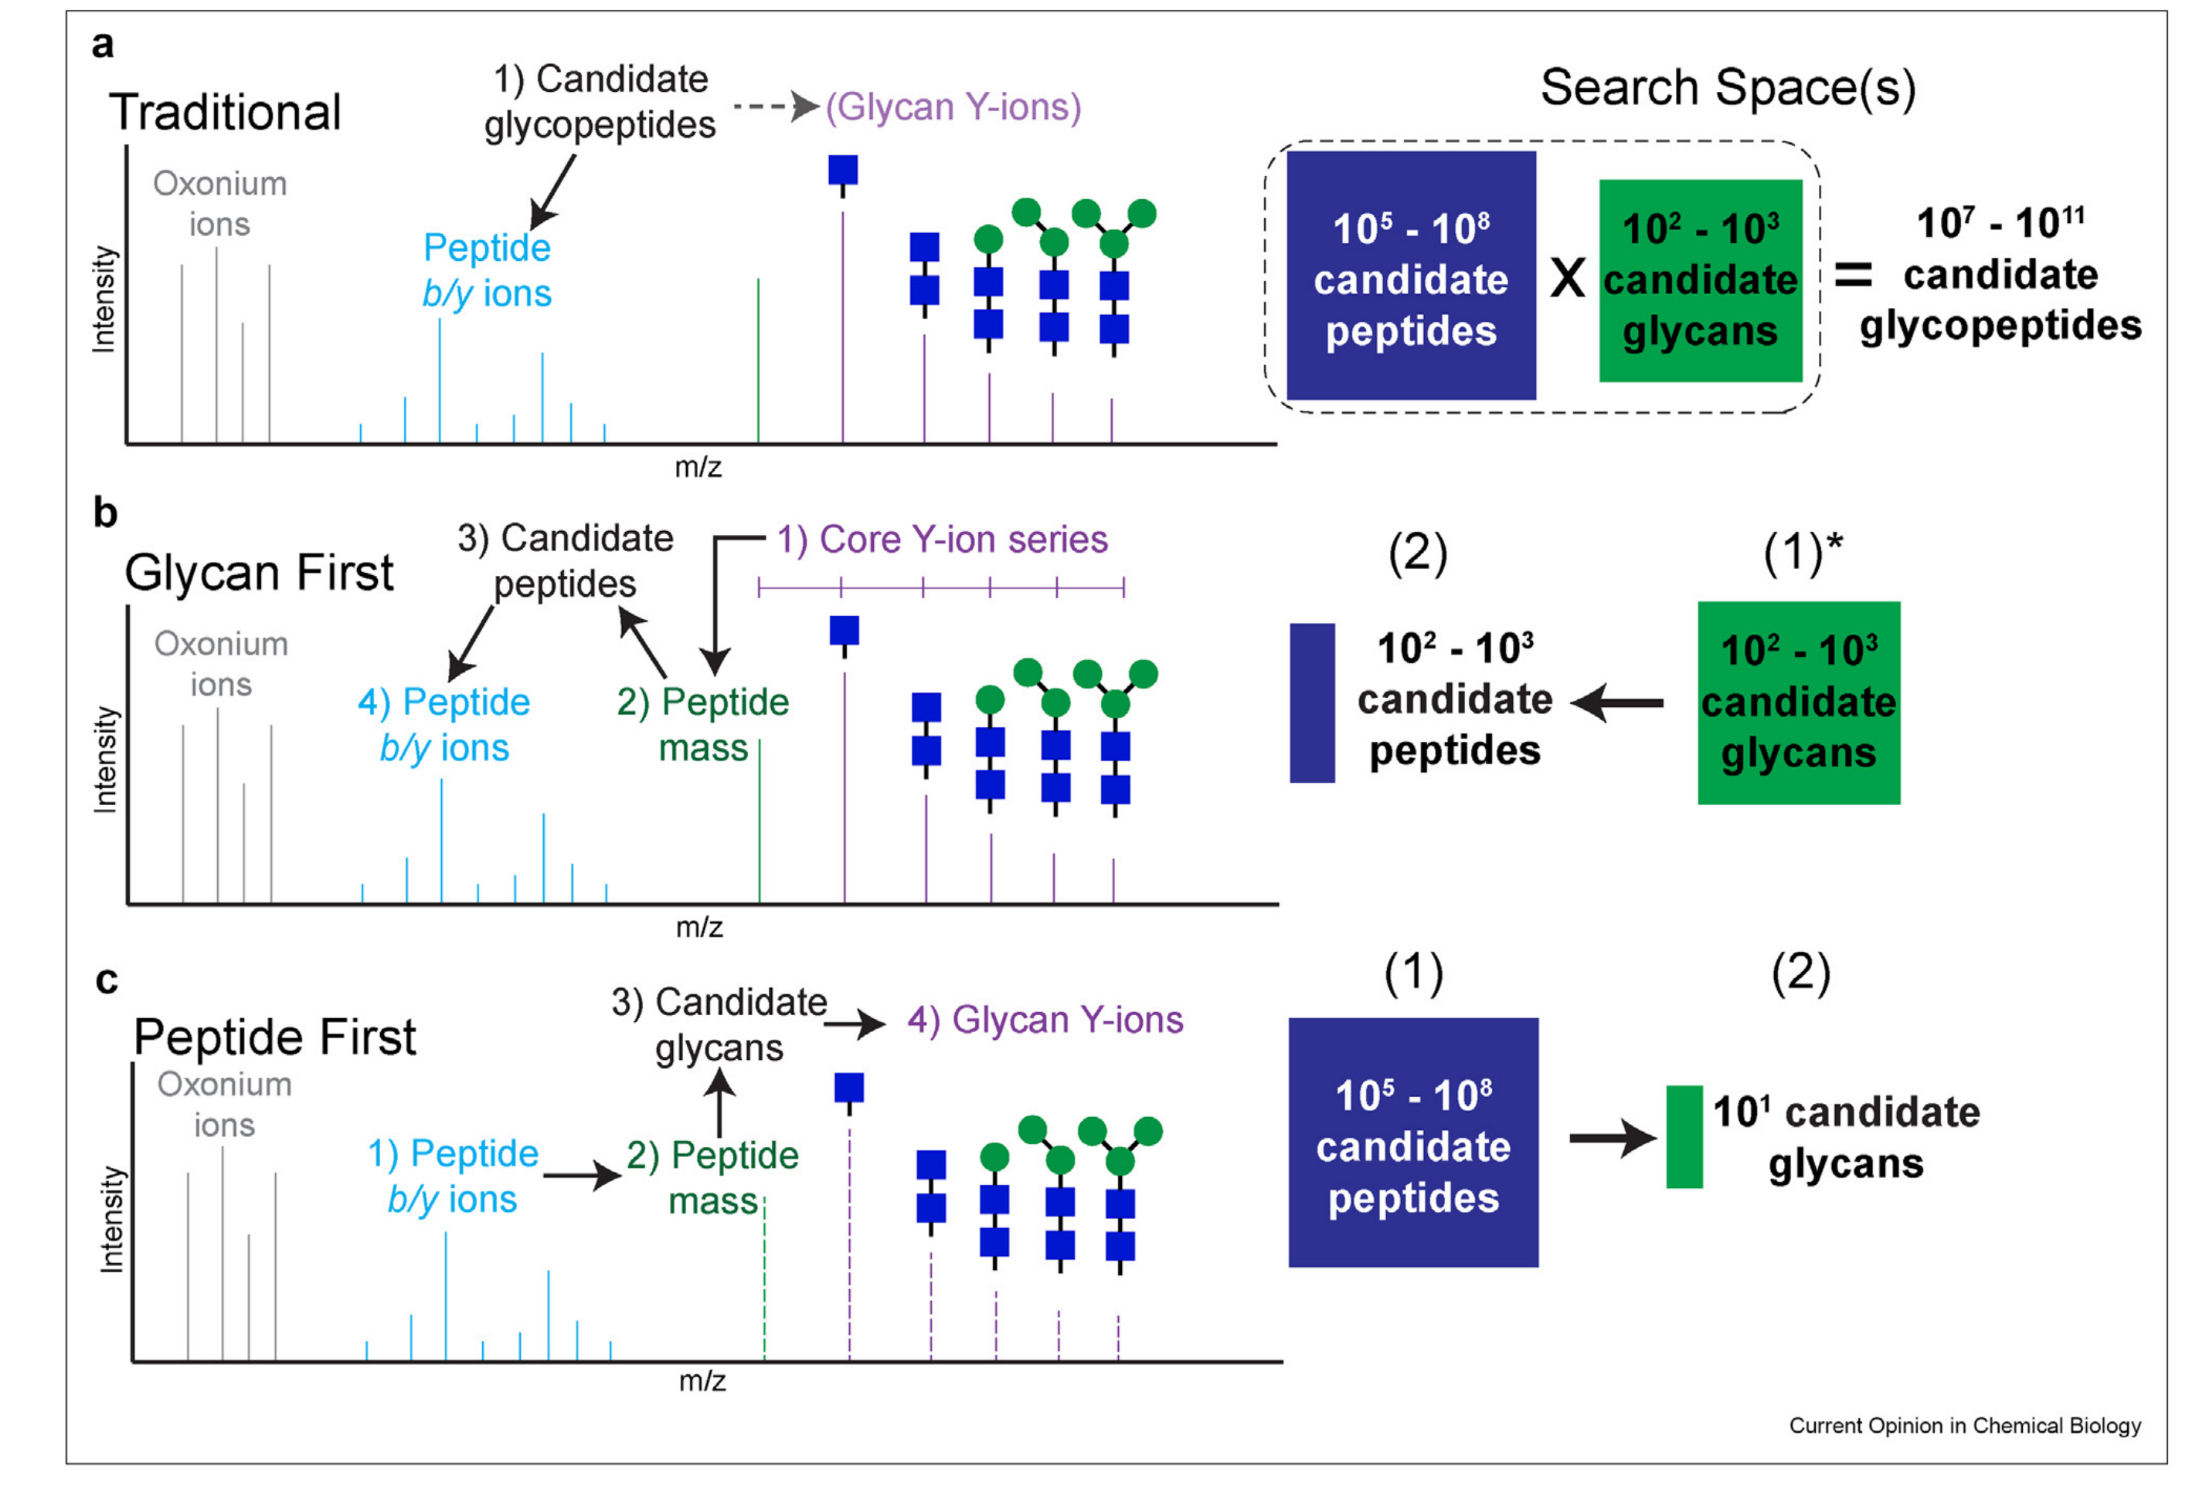
Different search strategies for the identification of glycopeptides
Traditional
Byonic
Glycan first
StrucGP, GPSeeker, Glyco-Decipher
Peptide first
pGlyco3, MSFragger-Glyco, O-Pair, O-Search (MS-dechipher)
Nesvizhskii et al, Current Opinion in Chemical Biology 2023, 72:102238

Slide 13
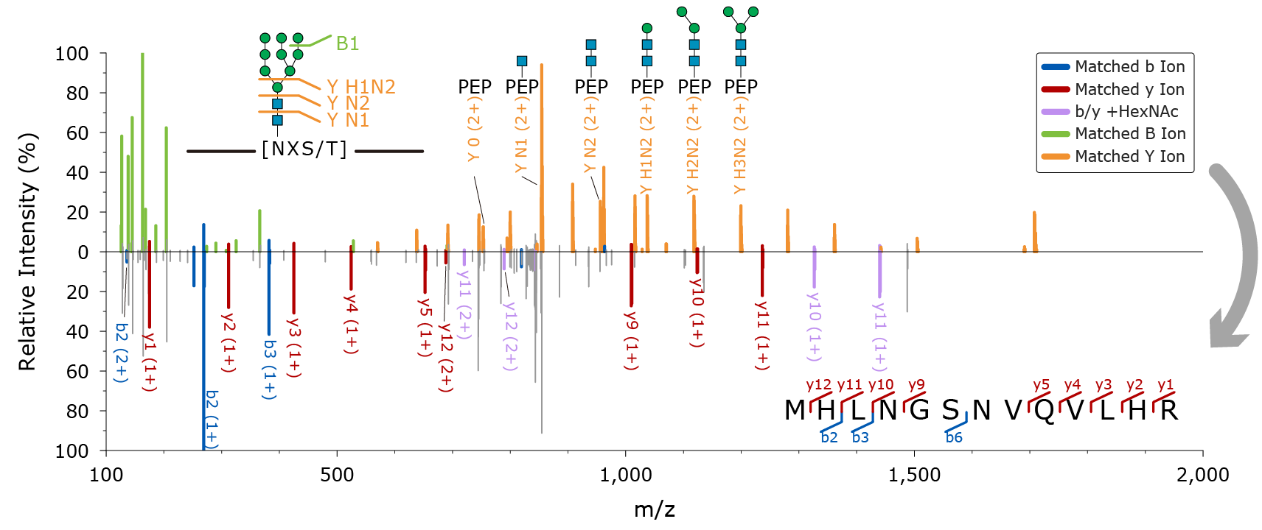
In silico deglycosylation: glycan database-independent identification
In Silico Deglycosylation
Core structure of N-glycans
Core structure matching
Y ions removal
Peptide mass derivation
Database search
✓ Avoid interference of glycan ions in identification
✓ Precise peptide mass with reduced search space
✓ Glycan database-independent spectral interpretation

Slide 14
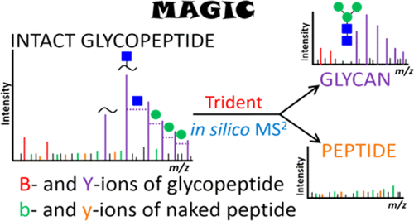
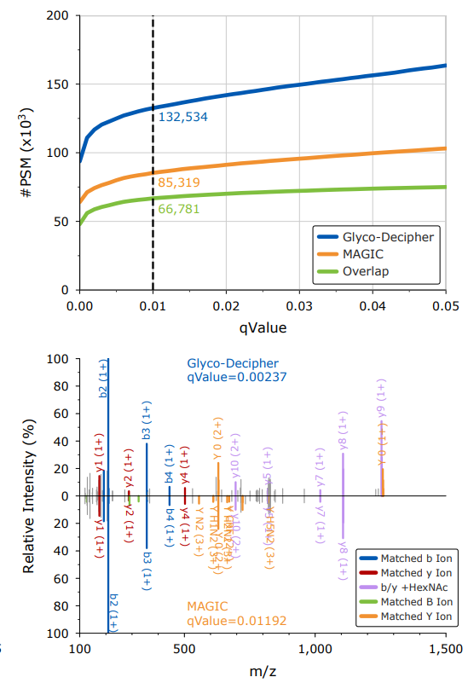
Comparison with MAGIC for in silico Deglycosylation
50% more PSM
Yu-Ju Chen, Ting-Yi Sung et al, Anal. Chem. 2015, 87, 4, 2466
Glyco-Decipher enables:
Precise peptide mass deviation
Improved glycan fragment ion removal

Slide 15
In Silico Deglycosylation can only identify peptide backbone squences when fragment ions are rich

Slide 16
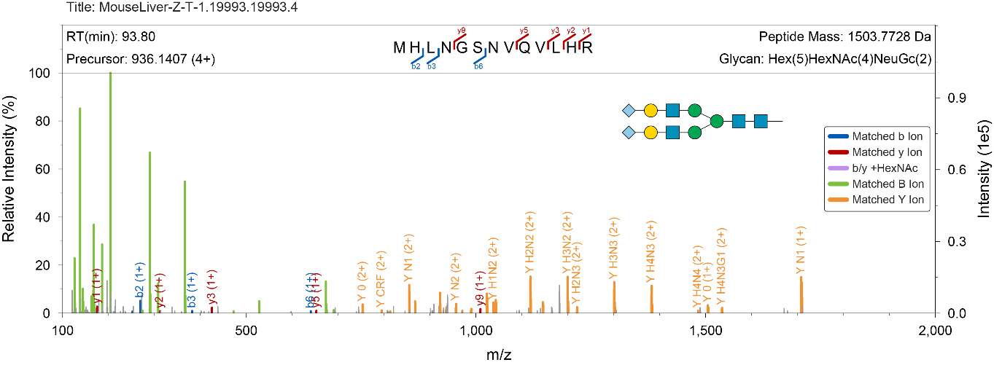

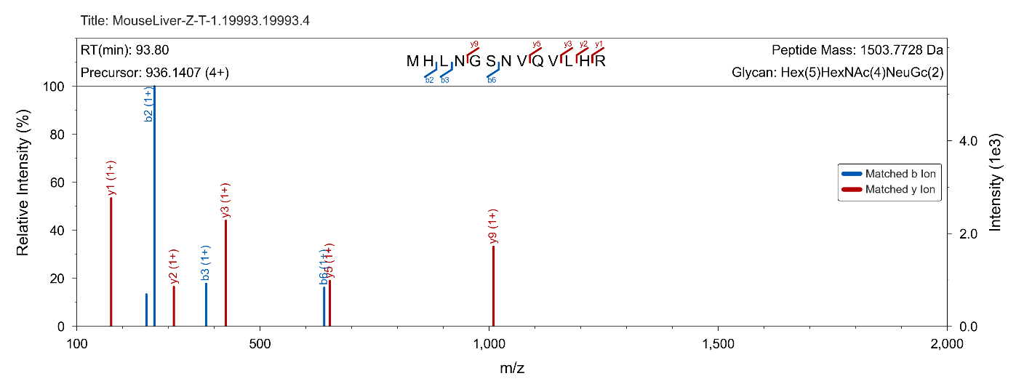
Many spectra lack sufficient ions to surport peptide identification
HCD spectrum of intact glycopeptides
The spectra of glycopeptides with low abundance or carrying acidic glycans often lack suffcient peptide fragment ions
Extracted peptide fragment ions

Slide 17
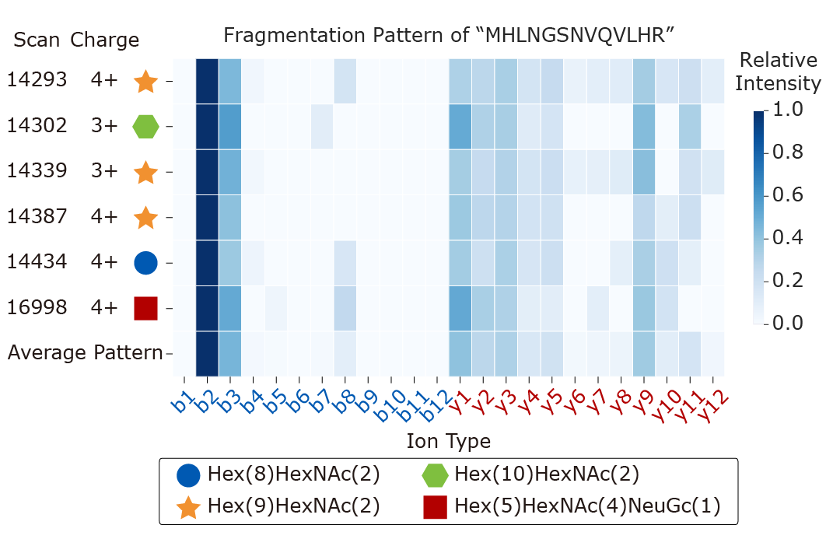

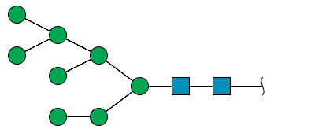
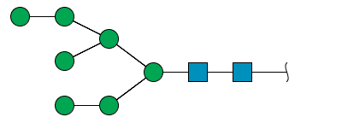


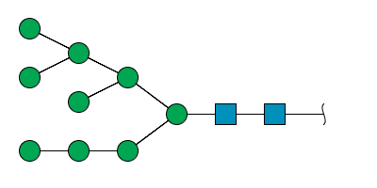
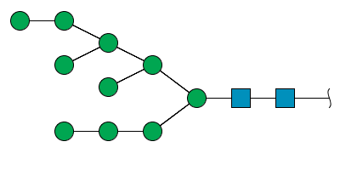
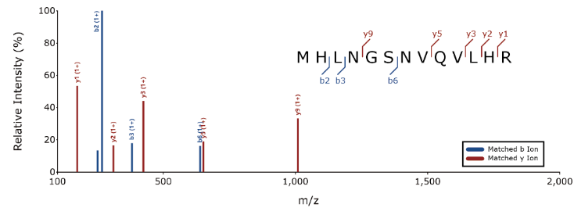
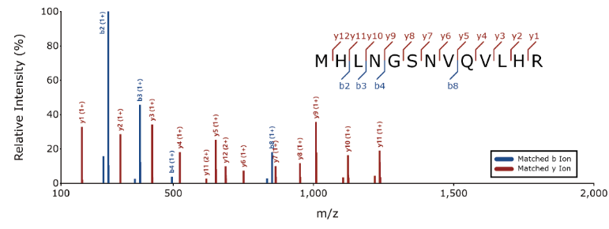
Exploiting the Similar Fragmentation Pattern of Shared Peptide Backbone
✓ High Micro-Heterogeneity of Glycosylation: Many different glycopeptides share the same peptide backbone
✖ Existing Software Ignore the Connection Between Spectra
MHLNGSN*VQVLHR
MHLNGSN*VQVLHR
MHLNGSN*VQVLHR
MHLNGSN*VQVLHR
MHLNGSN*VQVLHR
MHLNGSN*VQVLHR
MHLNGSN*VQVLHR
Low abundance
Acidic glycans
High abundance
Nuetral gkycans
Similar fragmentation patterns for
the shared peptide backbone of different glycopeptides
Lack of peptide fragments
Rich in peptide fragments
Same peptide mass
Similar fragment pattern
Spectra expansion
Notes:
9 目前所有糖肽的解析软件只对一张谱图进行解析，他忽略了谱图之间的联系。我们知道蛋白质糖基化是高度异质性的，糖链的这种多样性给分析带来了挑战，但同时也给我们带来了谱图之间的联系。各种性质不同的糖链连接于同一条肽段，有些糖链是酸性、有些是中性的，有些丰度高、有些丰度低。低丰度、酸性糖链的糖肽，肽段的碎裂效率比较低，碎片离子很少。仅仅凭其本身的谱图是不可能得到鉴定的。另一方面，高丰度、中性糖链的糖肽，肽段碎裂比较好，比较容易鉴定。那我们是否能将这两类谱图关联起来实现左边的谱图的鉴定？这是完全有可能的，因为它们有相同的肽段骨架。可以利用相同的肽段分子量、相似的碎片离子模式将这两个谱图关联起来。所以我们这种谱图拓展的策略就是利用蛋白质糖基化高度异质性的特点，通过已经鉴定到的糖肽谱图去鉴定其他糖肽的谱图，从而提高谱图解析率。这个策略能否成功的关键是肽段骨架的碎片离子模式是否相似。

Slide 18
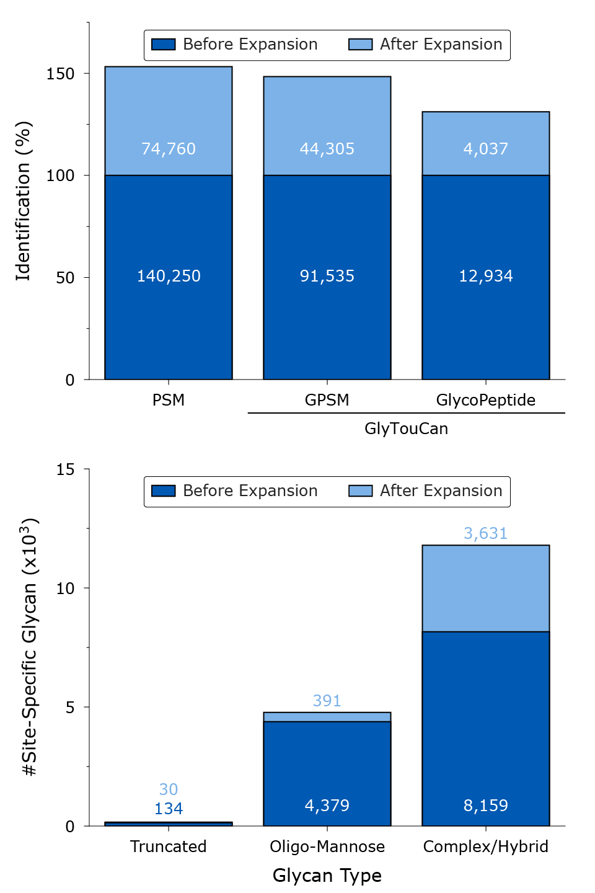
Improved Glycopeptide Identification Sensitivity
>50%
>30%
Glyco-Decipher enables the identification of glycopeptide spectra with poor peptide fragmentation.

Slide 19
Workflow of Glyco-Decipher
Spectra with rich peptide fragment ions
(1) Efficient in silico deglycosylation algorithm
Spectra with poor peptide fragment ions
(2) Spectra expansion technique
Exploiting the connection between spectra
Glycan mass=glycopeptide mass -peptide mass
Glycan profiling
Glycan database independent peptide identification scheme

Slide 20
Glycan Database-Independent Profiling of Glycan Mass
Distinct glycan profiles across mouse tissues
Brain
Database-independent peptide identification
Comprehensive profiling of glycan mass
Discovery of unexpected glycans
Heart
virtual MALDI spectra of glycans
Kidney
A dataset containing 1,386,844 tandem mass spectra acquired by stepped collision energy HCD (sceHCD) fragmentation for intact glycopeptides from five mouse tissues (brain, heart, kidney, liver and lung) was used for the performance evaluation.
Data sources: Ming-Qi Liu, ... Catherine C. L. Wong, Si-Min He & Peng-Yuan Yang , Nat. Commun., 2017, 8, 438
Liver
Lung

Slide 21
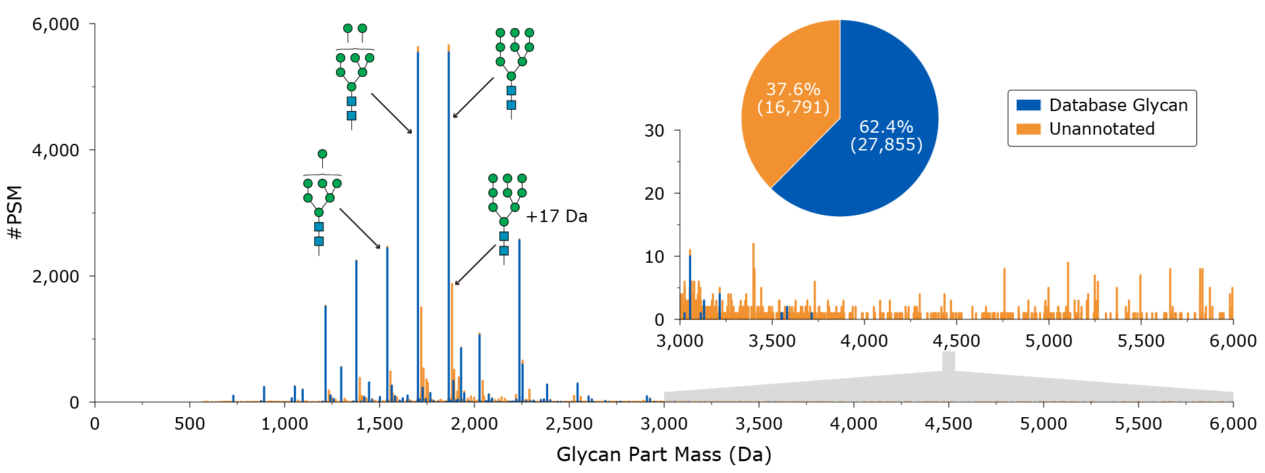
Glycan Mass profile indcates unexpected glycans
Glycan database-independent peptide identification
Comprehensive profiling of glycan mass
Discovery of unexpected glycans

Slide 22
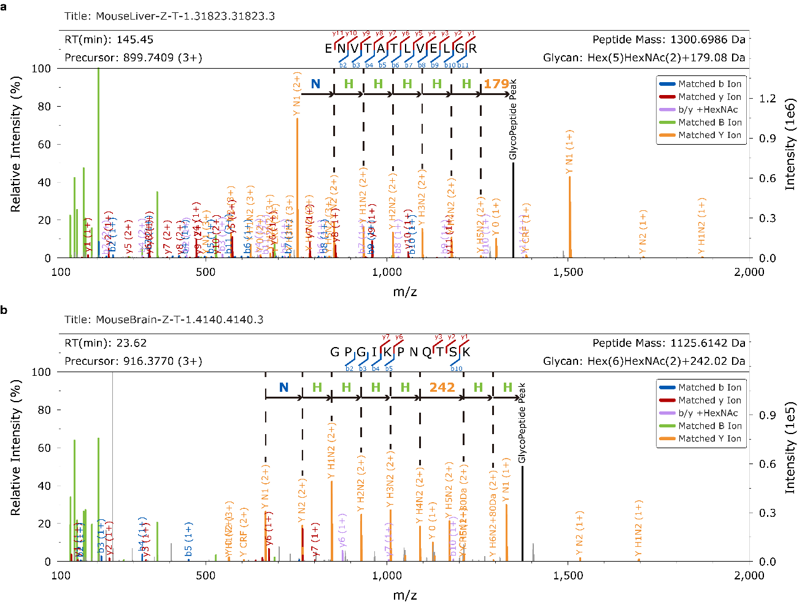
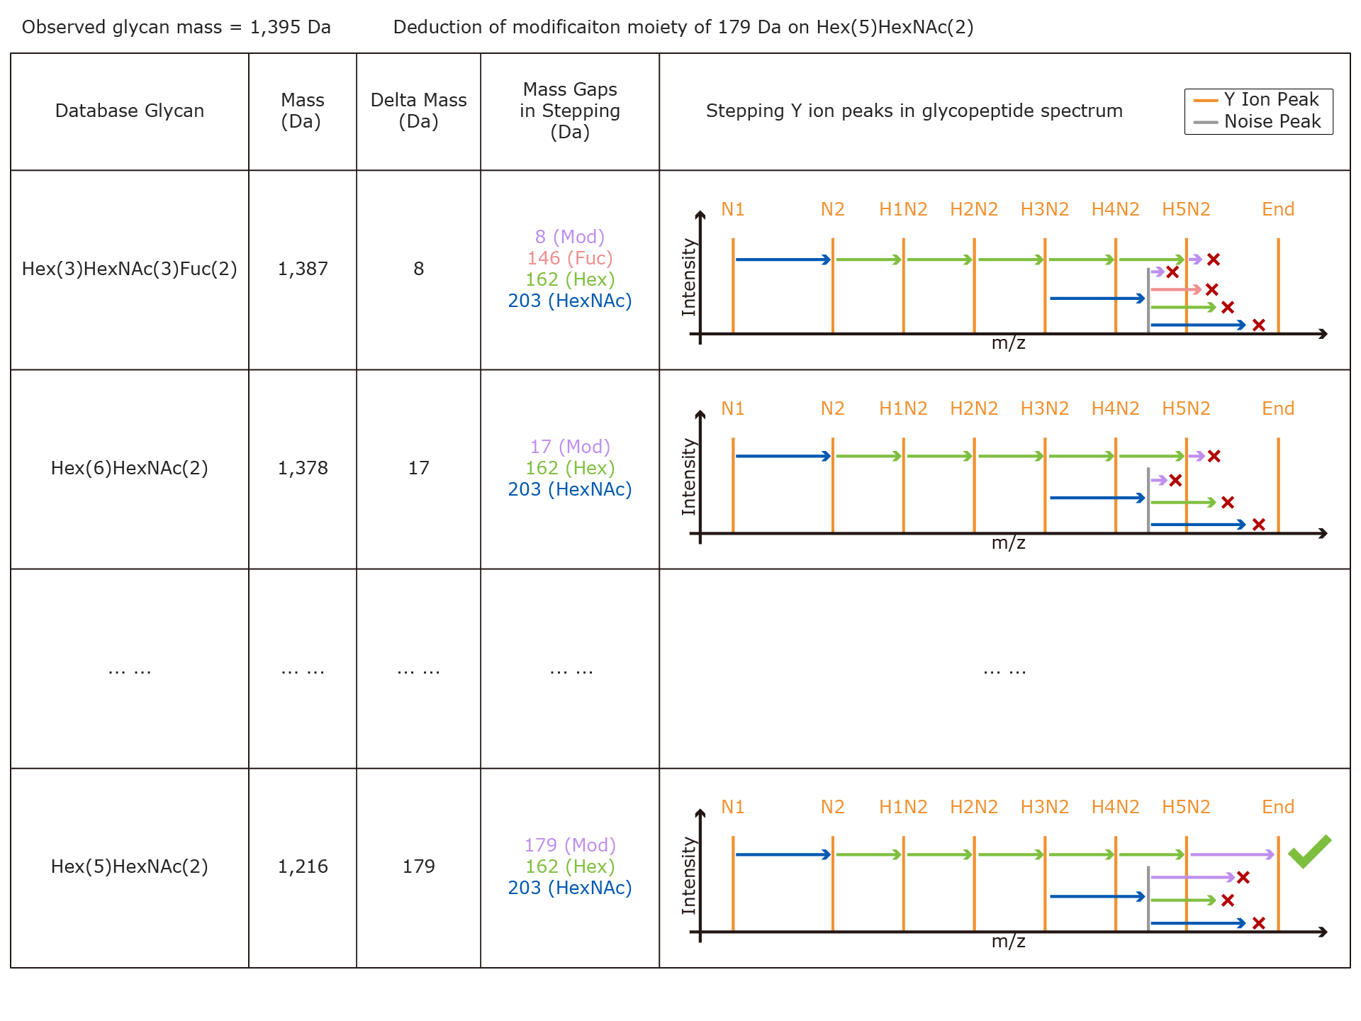
Monosaccharide Stepping Reveals Modification on Glycan
Examples of glycan modification
179 Da (Hexose + 17 Da)
242 Da (Hexose + 80 Da)
Search glycans around unexpected mass values
Utilization of stepwise Y ions of glycan fragmentation

Slide 23
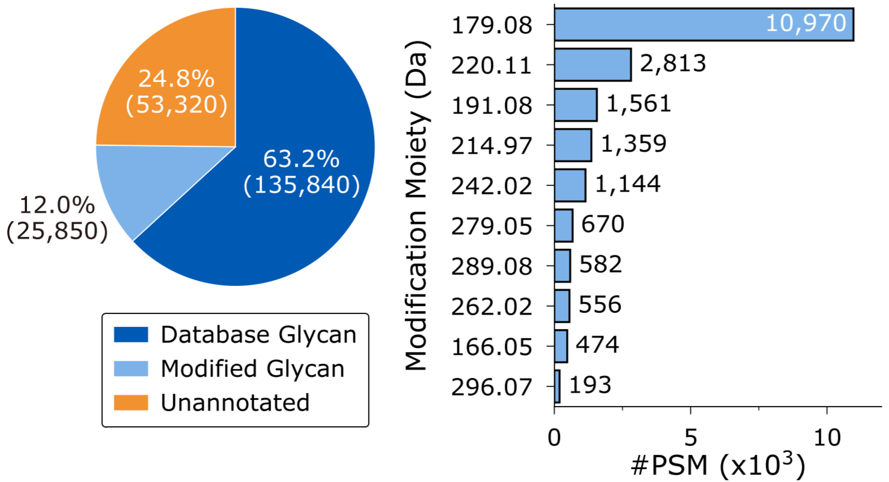
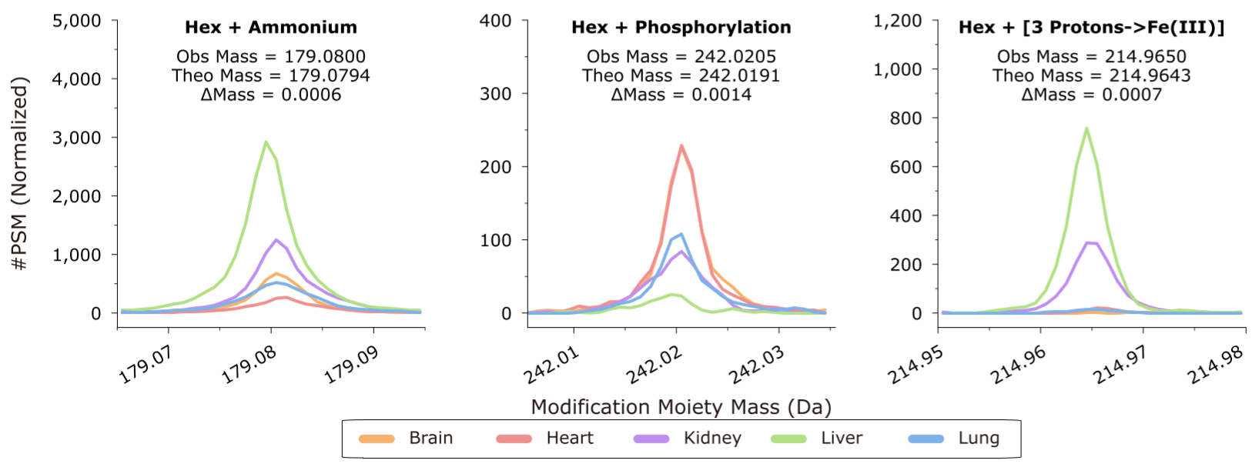
Discovery of Modification Moiety on Glycan
Glycan identification for 25,850 additional spectra
Discovery of modified glycans beyond database
Uncover chemical/biological modifications on glycan

Slide 24
Workflow of Glyco-Decipher
Spectra with rich peptide fragment ions
Efficient in silico deglycosylation algorithm
Spectra with poor peptide fragment ions
Spectra expansion technique
Exploiting the connection between spectra
Glycopeptides with modified glycans
Monosaccharide stepping algorithm
Glycan profiling at different levels
Glycan database independent peptide identification scheme

Slide 25
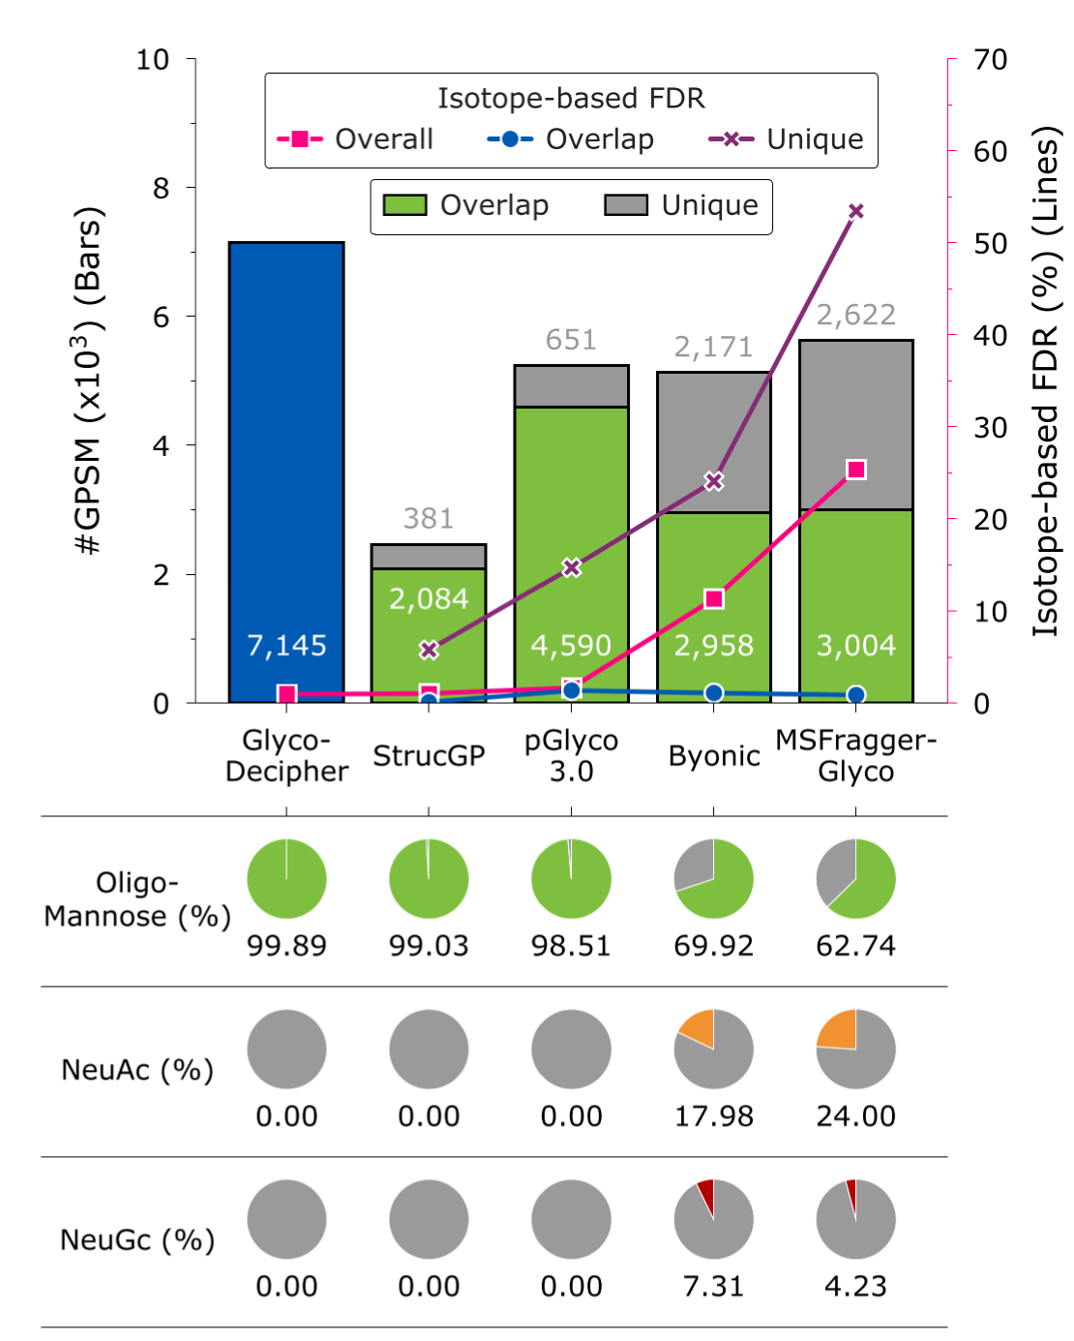
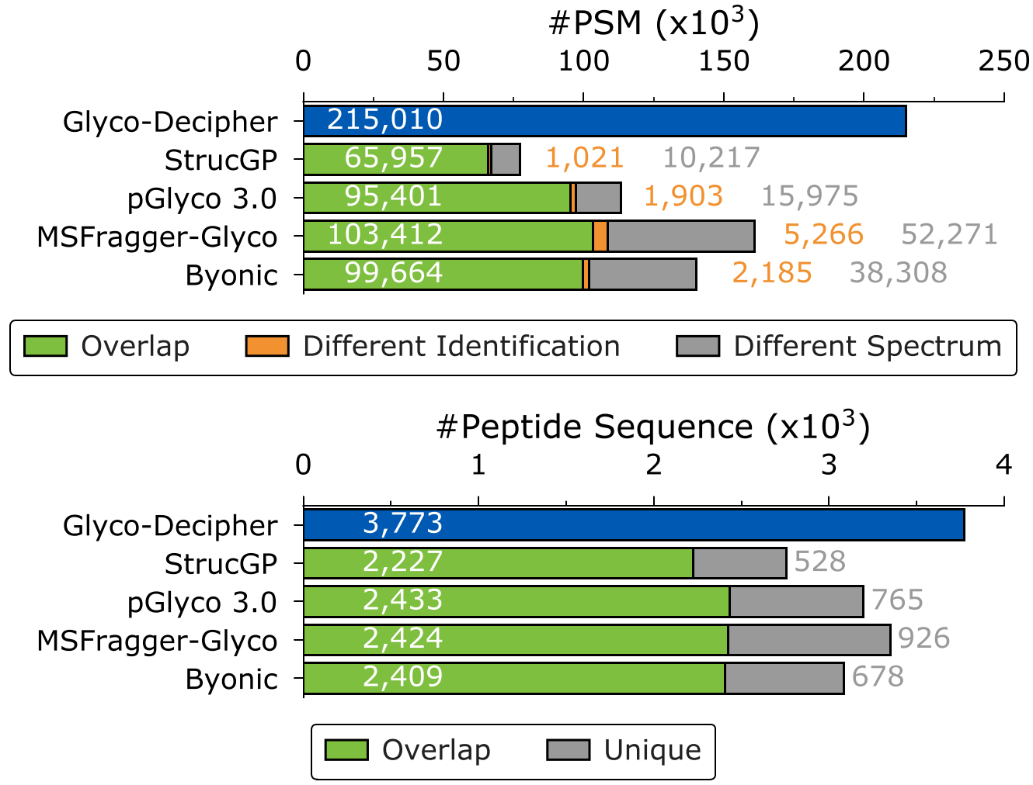
Comparison with Existing Glycoproteomics Softwares
Identification performance evaluation with
dataset of mouse tissues
FDR analysis with ¹³C/¹⁵N-labeled yeast dataset
Note: Comparison was performed in 2022

Slide 26
Candidate glycans are determined by matching B/Y ions
Candidate glycans in the built-in (GlyTouCan) or user-provided database are scored by matching their theoretical fragment ions with experimental B/Y ions in glycopeptide spectra.
Spectrum examples of glycopeptides with the same peptide backbones but different glycan compositions identified by Glyco-Decipher.
The idential peptide and the identical glycan mass
Mass(NeuAc) + Mass(Hex) = Mass(NeuGc) + Mass(Fuc)

Slide 27
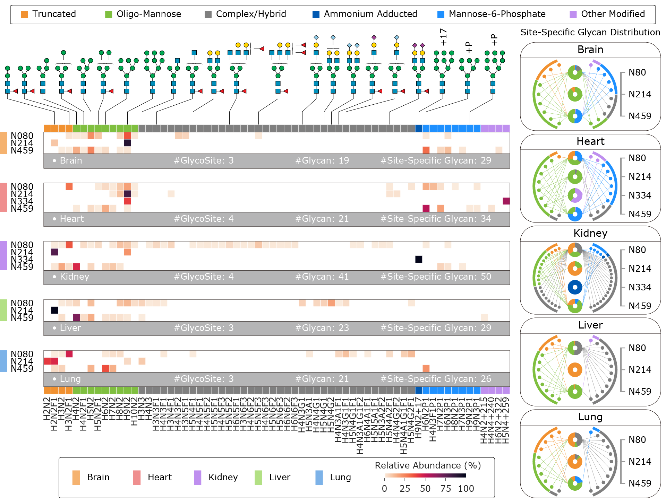
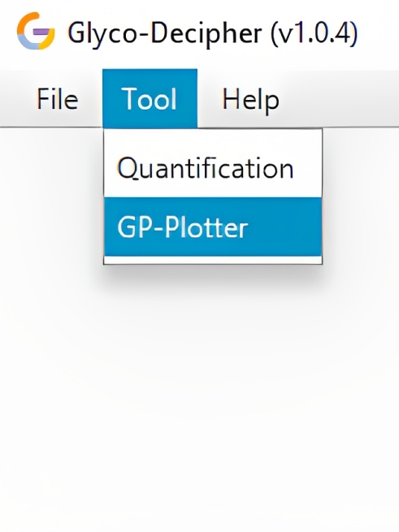
Abundance Distribution of Glycosylation at Protein Sites
Protein example:
Prosaposin (UniProt: Q61207)
Brain
Heart
Mouse Tissues
Kidney
Liver
Lung
Quantification with Glyco-Decipher enables abundance analysis
at site level

Slide 28




Features of Glyco-Decipher
Glyco-Decipher
Glycan database-independent spectrum interpretation
Comprehensive glycan profiling with the discovery of novel modified glycans
Spectrum expansion strategy deeply reveals micro-heterogeneity of glycosylation
User-friendly graphic interface with statistical post-analysis

Slide 29
Outline
01
Glyco-Decipher: Comprehensive Interpretation of N-Glycopeptide Mass Spectra
02
GP-Plotter: Flexible Visualization of Glycoproteomics Mass Spectrometry Data
03
MS-Decipher: Novel Strategy for Identification of O-Glycopeptide
04
Glyco-Decipher 2.0: Towards Simultaneous Analysis of O-/N-Glycopeptides

Slide 30
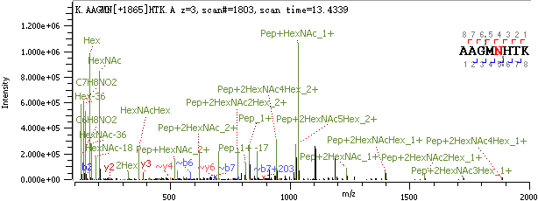
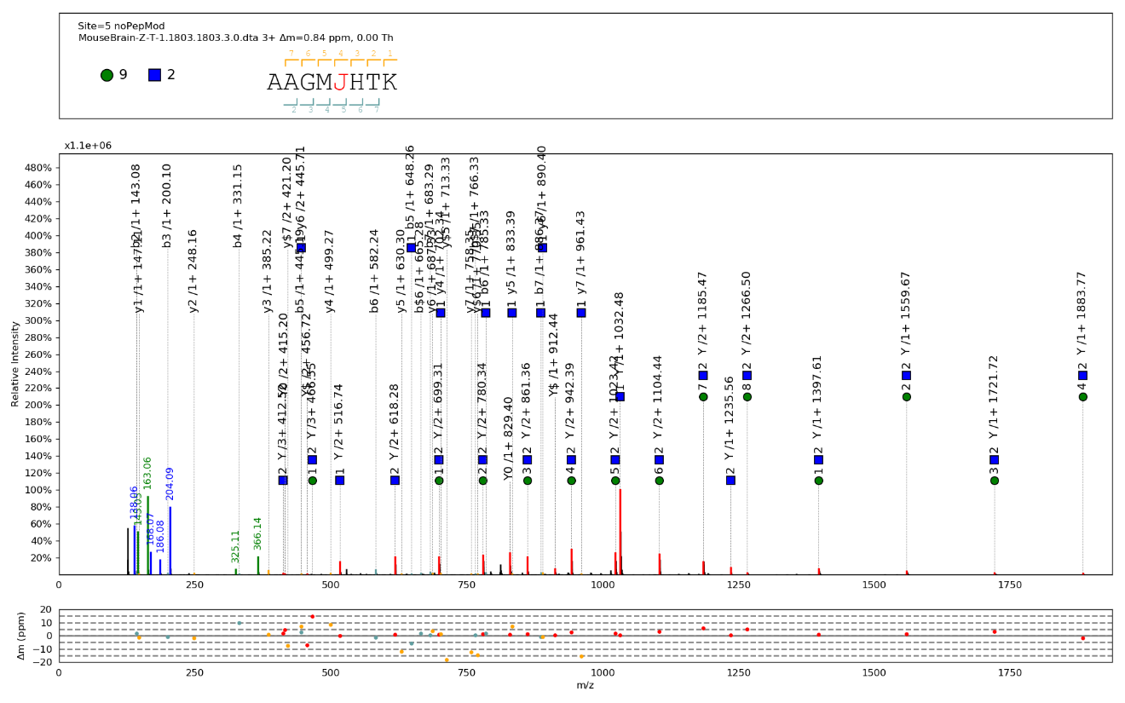
Inflexible Spectral Visualization of Existing Software
Byonic
✖ Pixel-based image output
✖ Lack User customization
✖ Missed Y ion annotation for complex glycans
✖ Only support their own identification results
pGlyco
Software tool to provide universal
spectral visualization and image generation
for glycoproteomics is still needed!

Slide 31
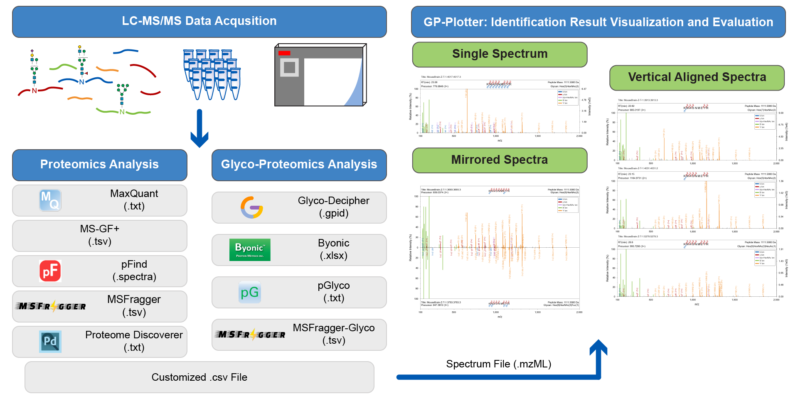
GP-Plotter for Glycoproteomics Data Visualization
Input: standard mass spectrometry file format (.mzML)
Supports for proteomics and glycoproteomics result of common identification tools
Supports for user-customized csv file
Multiple modes for data visualization and image generation (Single / Mirror / Vertical alignment)

Slide 32
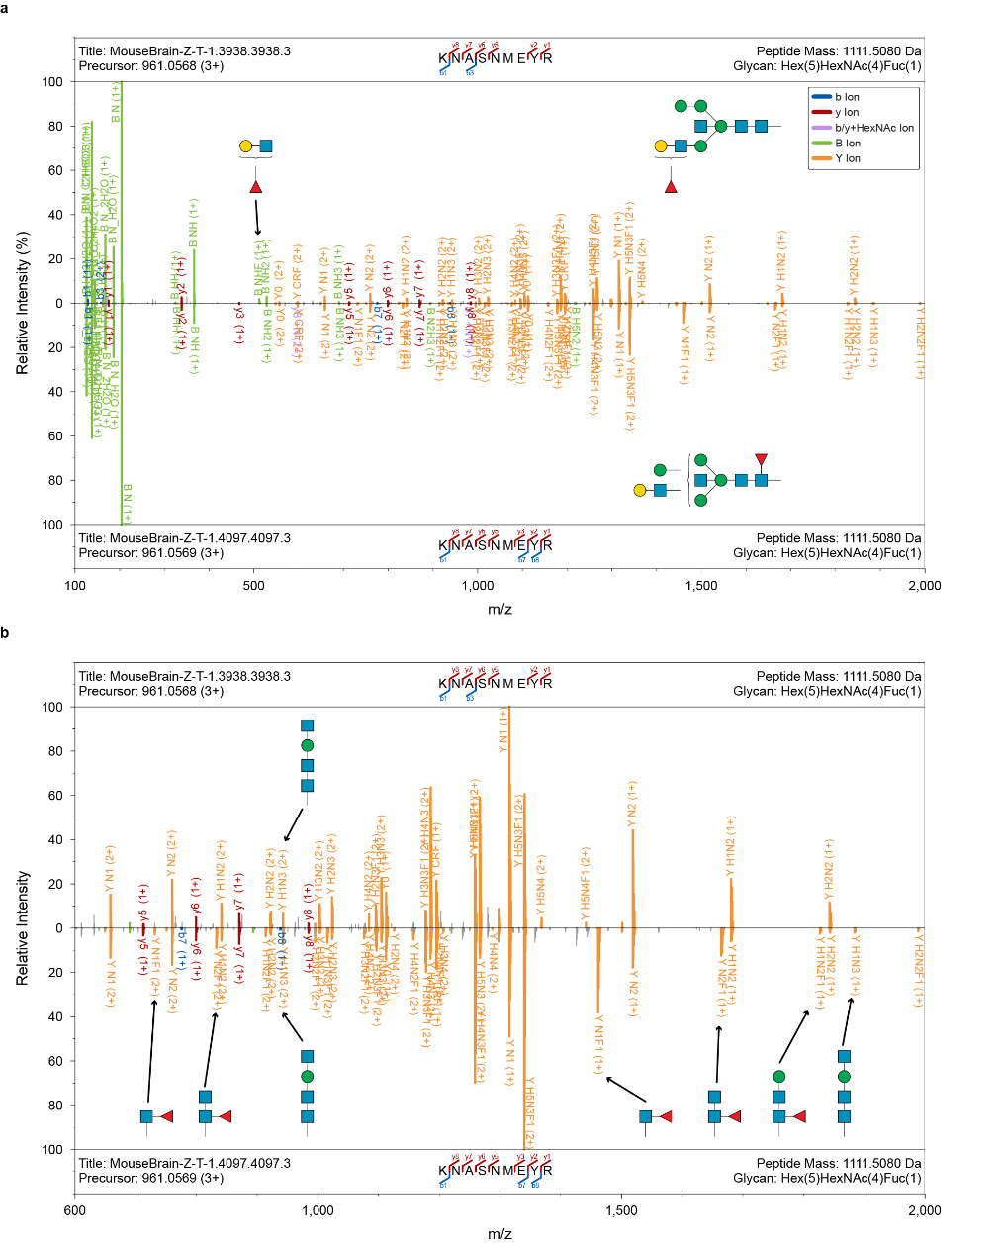
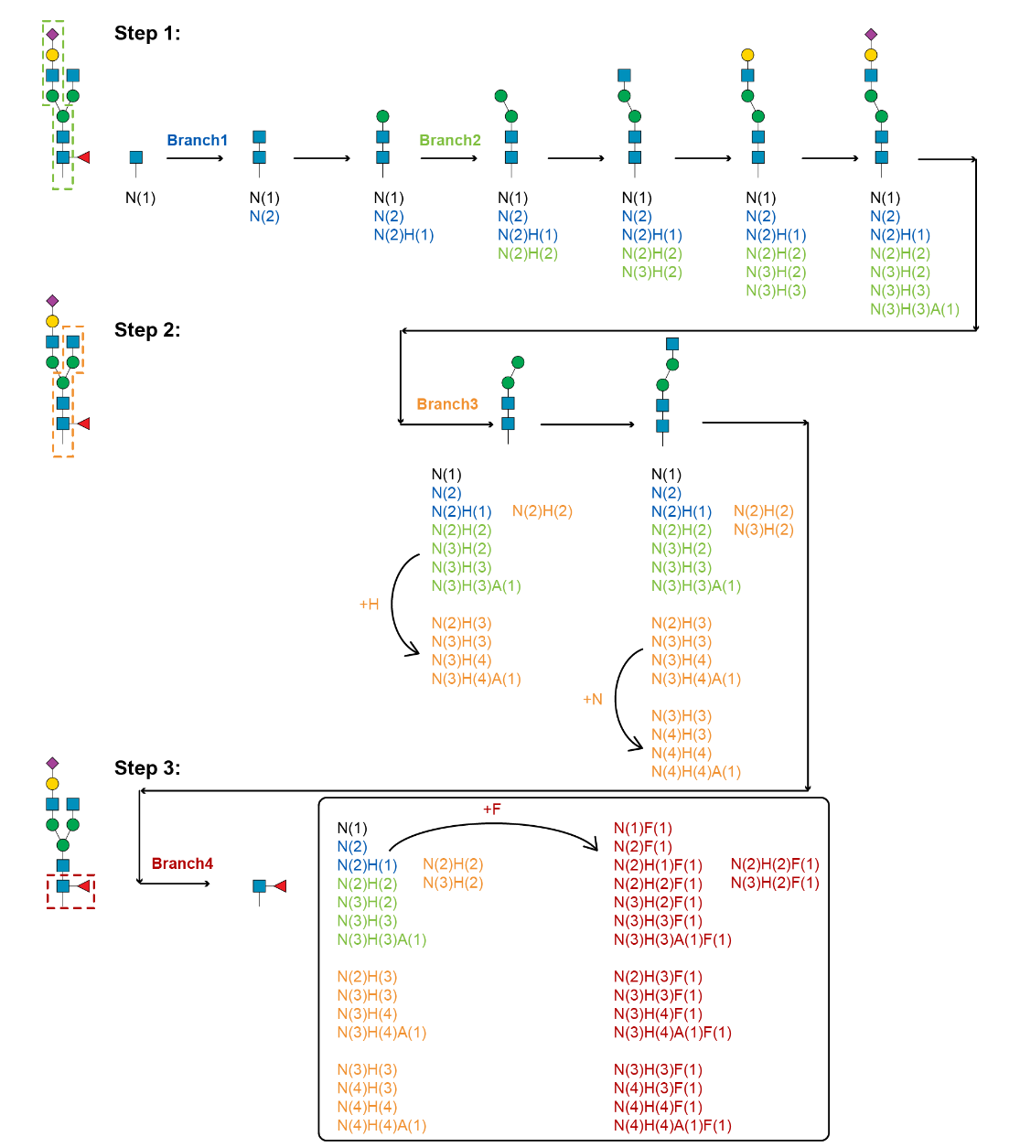
Structure determination of isobaric glycans with GP-Plotter
Comprehensive annotation
of fragment ions
Glycan Structure
Core Fucosed / Bisecting glycan structures

Slide 33
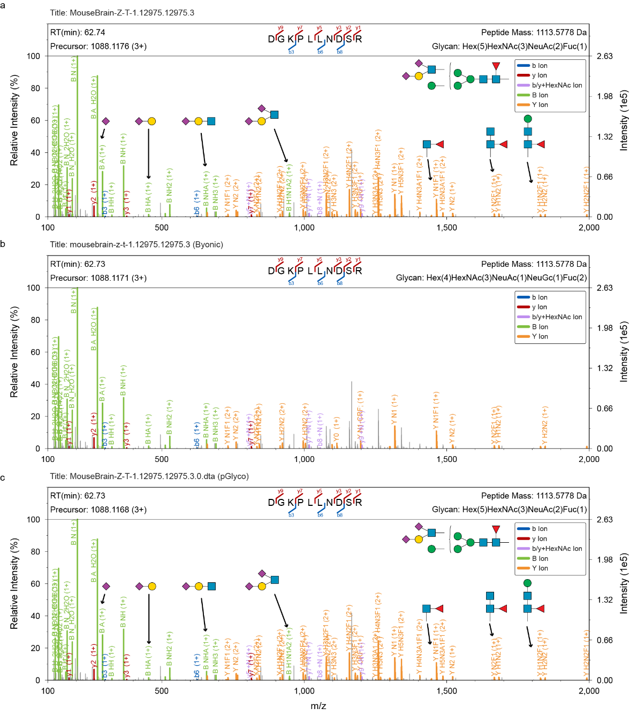


Visualization for Identification Results of Different Software
User-customized csv enables flexible spectral visualization
Glyco-Decipher
Essential Column | Information
File | Name of a MS file
Scan | Scan number of a spectrum
Peptide | Amino acid sequence
Modification | Modification on peptide
Glycan | Saccharide composition of a glycan
GlycanStructure | WURCS 2.0 or GlycoCT encoded glycan structure
Byonic
Glycan structure resources:
pGlyco
GlyTouCan
GlyCosmos

Slide 34
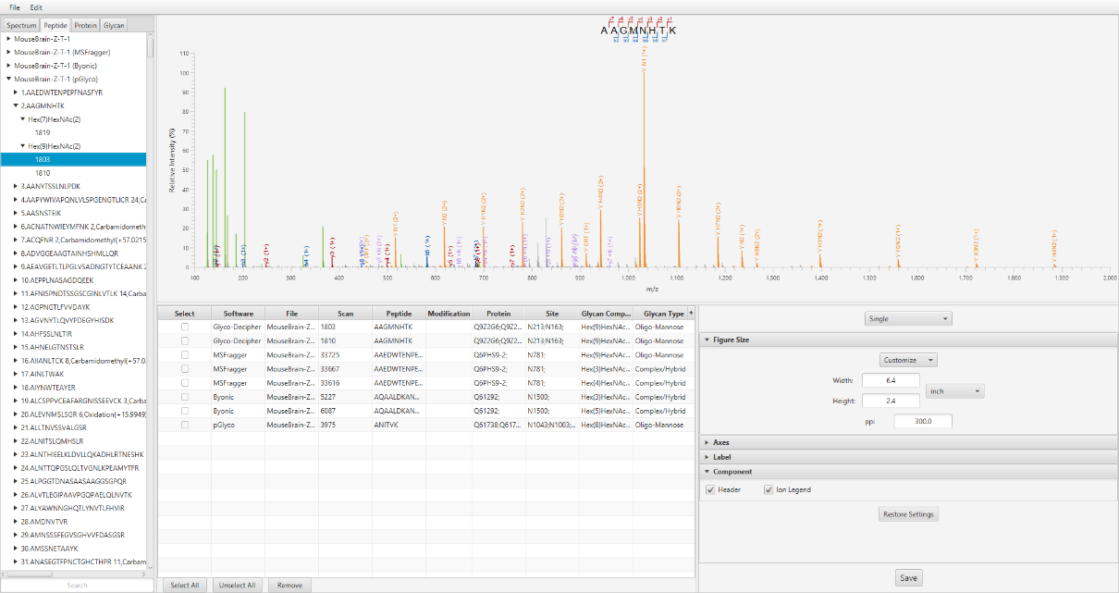
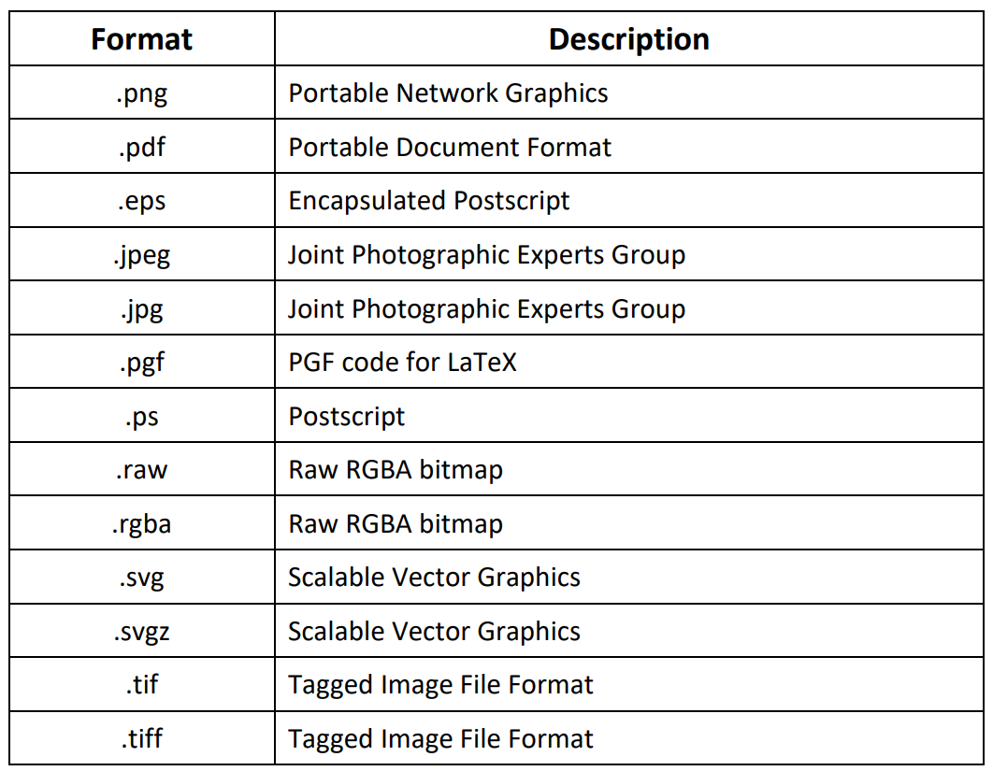
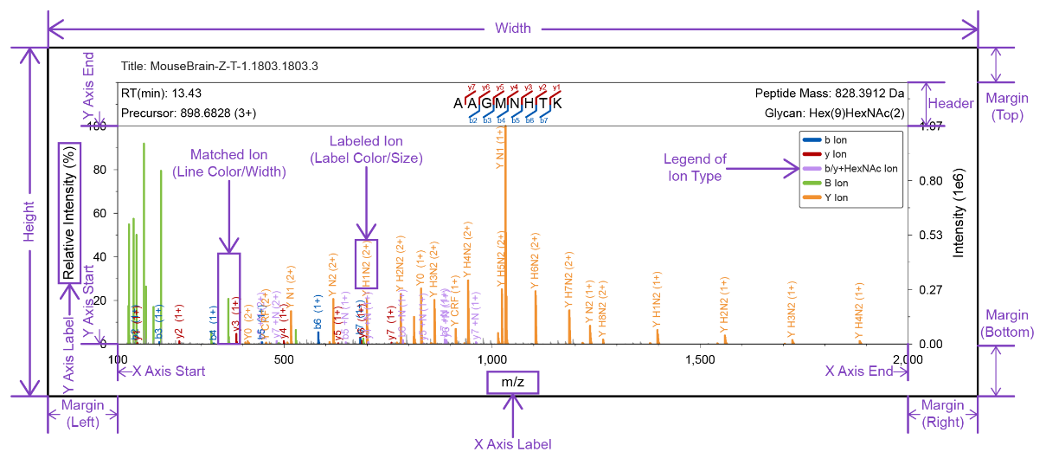
GP-Plotter: Flexible Image Output
User-friendly graphical interface
Flexible data input and image output
Vector
graphics
Image customization

Slide 35
Outline
01
Glyco-Decipher: Comprehensive Interpretation of N-Glycopeptide Mass Spectra
02
GP-Plotter: Flexible Visualization of Glycoproteomics Mass Spectrometry Data
03
MS-Decipher: Novel Strategy for Identification of O-Glycopeptide
04
Glyco-Decipher 2.0: Towards Simultaneous Analysis of O-/N-Glycopeptides

Slide 36
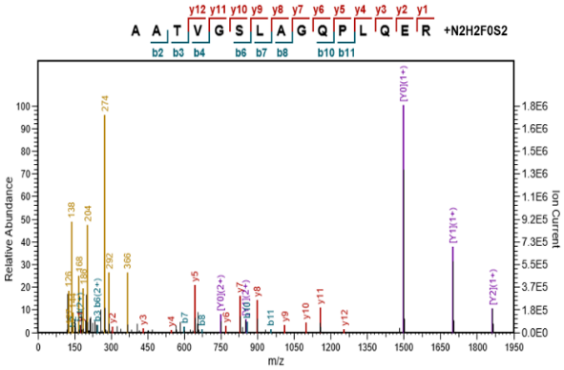

Reduced Search Space with O-Search Strategy
Ye et al, Anal. Chem., 2019. 91(6), 3852-3859
Setting varible glycan modifications on peptide level is the same to setting the mass offset in MSFragger-Glyco (Nesvizhskii et al, Nat. Methods, 2020, 17, 1125)
Search space for O-glycopeptide is significantly reduced by enumerating combinations of O-glycans

Slide 37


Implementation of O-Search Strategy in MS-Decipher
MS-Decipher: A User-Friendly Proteome Database Search Software with an Emphasis on Deciphering the Spectra of O-Linked Glycopeptides
O-Search-Pattern: A searching tool utilizing the Y-ion pattern to enhance O-glycopeptide identification for the analysis of O-GalNAc glycoproteome
Bioinformatics, 2022, 38(7), 1911-1919
Anal. Chem., 2023, 95(26), 9761-9768

Slide 38
Outline
01
Glyco-Decipher: Comprehensive Interpretation of N-Glycopeptide Mass Spectra
02
GP-Plotter: Flexible Visualization of Glycoproteomics Mass Spectrometry Data
03
MS-Decipher: Novel Strategy for Identification of O-Glycopeptide
04
Glyco-Decipher 2.0: Towards Simultaneous Analysis of O-/N-Glycopeptides

Slide 39


Co-Existence of N-/O-Glycosylation on Proteins
“O-Follow-N” glycosylation rule of SARS-CoV-2 spike protein
Fu Gao et al, Cell Res., 2021, 31(10), 1123-1125
High Density of N-/O- glycosylation shields of receptor-type protein tyrosine phosphatase alpha (PTPRA)
Kay-Hooi Khoo et al, JACS Au, 2023, 3(7), 1864-1875

Slide 40


HILIC Separation of N-/O-Glycopeptides
N-Glycopeptide
O-Glycopeptide
Zhongyu Wang, Zheng Fang, Luyao Liu, He Zhu, Yan Wang, Changrui Zhao, Zhimou Guo, Hongqiang Qin, Yongzhan Nie, Xinmiao Liang, Mingming Dong*, and Mingliang Ye*. Anal. Chem., 2023, 95(19), 7448-7457

Slide 41
Distiguish the spectra of N-/O-Glycopeptides
Data filtering
O-glycopeptides
Exclude the spectra already identified as N-glycopeptides
Exclude the spectra with 138/144 oxonium ion ratios > 5
N-glycopeptides
At least 3 Y ions from the pentasaccharide core structure
Presence of N-X-S/T motif in peptide sequence
Problems
Distinct fragmentation features of N- and O-glycopeptides
Overlapped glycan compositions for N- and O- glycosylation
Site localization for glycopeptides with multiple potential N- and O- glyco-sites
Notes:
In Glyco-Decipher, all spectra for PSMs of N-glycopeptides should have three or more Y ions, and the spectra for O-glycopeptides should not have these ions.
In Glyco-Decipher, all spectra for PSMs of N-glycopeptides should have three or more Y ions, and the spectra for O-glycopeptides should not have these ions.

Slide 42






Strategies for Simultaneous N-/O-Glycosylation Analysis
Peptide Mass Deviation
Spectrum Expansion
Peptide mass deviation with core structure fragment ions
Utilization of peptide fragmentation pattern improves identification sensitivity
Oxonium Ion
Mass Offset
Site Localization
Spectrum
Core Structure
Spectrum
Expansion
Spectrum Classification
Mass Offset
Peptide Deviation
Distinguish N-/O- glycopeptide spectrum with 138/144 oxonium ion pattern
Enumeration mass combinations of possible glycans on peptide
Site localization and glycan composition assignment with ETXXD fragmentation method

Slide 43
Glyco-Decipher 2.0 Towards Comprehensive N-/O-Glycopeptide identification
N-Glycopeptide
N-/O- Glycopeptide
An open-source database search tool
(Nat. Commun., 2022)
Glyco-Decipher
2.0
MS-GF+
Glyco-Decipher
Tool Box
GP-Plotter
GP-Quant
… …
The in-house developed database search tool
O-search
MS-Decipher
（O-search）
MS-Decipher
(O-Search-Pattern)
(Anal. Chem., 2019)
(Bioinformatics, 2022)
(Anal. Chem., 2023)
O-Glycopeptide

Slide 44


How to access our software tools?
Way1:
QR code
https://github.com/DICP-1809
Way2: google Glyco-Decipher or glycopeptide decipher
Questions: Email to glyco_decipher@163.com

Slide 45

Acknowledgement
Software Download:
Group 1809, Dalian Institute of Chemical Physics, CAS
Prof. Hongqiang Qin
Jiawei Mao (O-Search, MS-Decipher)
Zheng Fang (Glyco-Decipher, GP-Plotter)
He Zhu (MS-Decipher, O-Search-Pattern)
Yao Chen (O-GlcNAc)
Luyao Liu (Automated Enrichment)
Xuyang Yue (O-GalNAc)
Zhongyu Wang (O-/N-Glycosylation)
Questions:
Email to: glyco_decipher@163.com
Collaboration
Dalian University of Technology
Assoc. Prof. Mingming Dong
Air Force Medical University/Xijing Hospital
Prof. Yongzhan Nie
Shanghai Institute of Materia Medica, CAS
Prof. Wei Huang
Group 2800, Dalian Institute of Chemical Physics, CAS
Prof. Xinmiao Liang
Prof. Zhimou Guo

Slide 46
An O-glycopeptide truncation strategy for heterogeneous O-GalNAc glycoproteomics characterization
Anal. Chem. 2023, 95, 10017
Figure 1. Workflow for serum O-GalNAc glycosylation analysis using the O-glycopeptide truncation strategy. O-glycopeptides are prepared from pooled human serum through sequential trypsinization, de-N-glycosylation, and HILIC enrichment. The enriched O-glycopeptides are then cleaved by other protease or O-glycopeptidase in the O-glycopeptide truncation strategy. The truncated O-glycopeptides were detected by LC-MS/MS analysis and database search using O-search in MS-decipher software.

Slide 47
Existing Problems in Data Analysis
GlyCosmos Database
Potential high density N- and O- glycosylation on proteins
Distinct fragmentation features of N- and O-glycopeptides
Overlapped glycan compositions for N- and O- glycosylation
Site localization for glycopeptides with multiple potential N- and O- glyco-sites
… …
1,516
95
191
N-Glycan
1,611
O-Glycan
286

